Slide 1
Lecture 2
Relational Model
UECS 1203
DATABASE SYSTEM FUNDAMENTALS

Slide 2
Chapter 2 - Objectives
Define the term data model.
Terminology of relational data model.
How tables are used to represent data.
Properties of database relations.
How to identify candidate, primary, and foreign keys.
Meaning of entity integrity and referential integrity.

Slide 3
Data Model
Integrated collection of concepts for describing data, relationships between data, and constraints on the data.
Has three components:
  a structural part
    Consists of a set of rules that define how the database is to be constructed
  a manipulative part
    Defining the types of operations (transactions) that are allowed on the data (includes the operations that used for updating or retrieving data and for changing the structure of the database)
  a set of integrity rules
    Which ensures that the data bound by the constraints and data is accurate (reliable)

Slide 4
Relational Model Terminology
Relation: table with columns and rows.
Attribute: named column of a relation.
Domain: set of allowable values for one or more attributes.
Tuple: a record of a relation.
Relational Database - collection of normalized relations with distinct relation names.
Example: City Guide relation

Slide 5
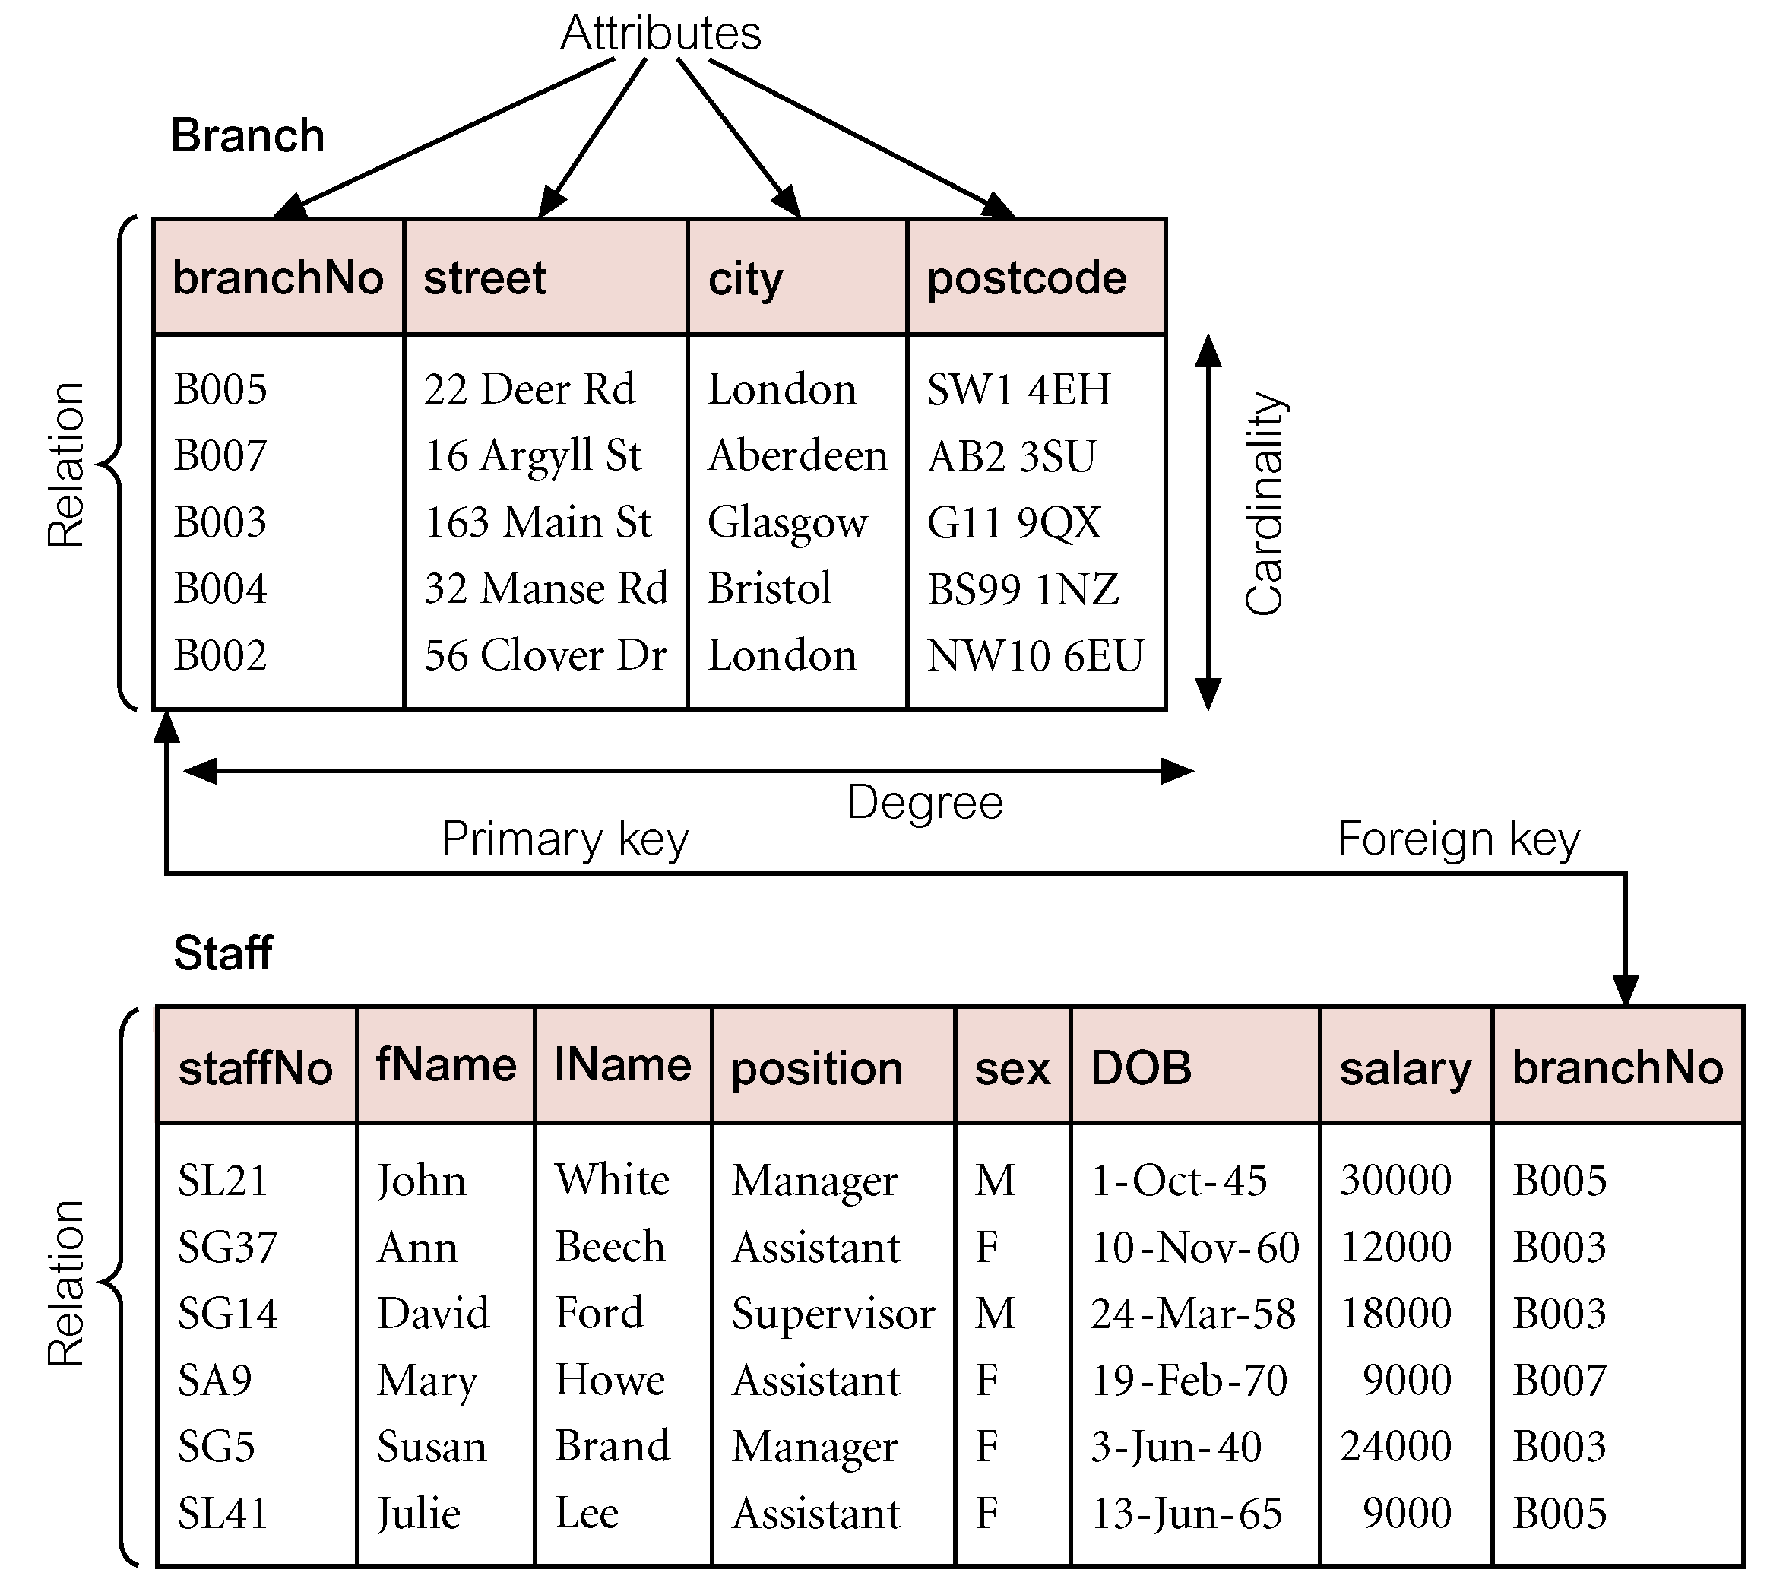
Instances of Branch and Staff Relations

Slide 6
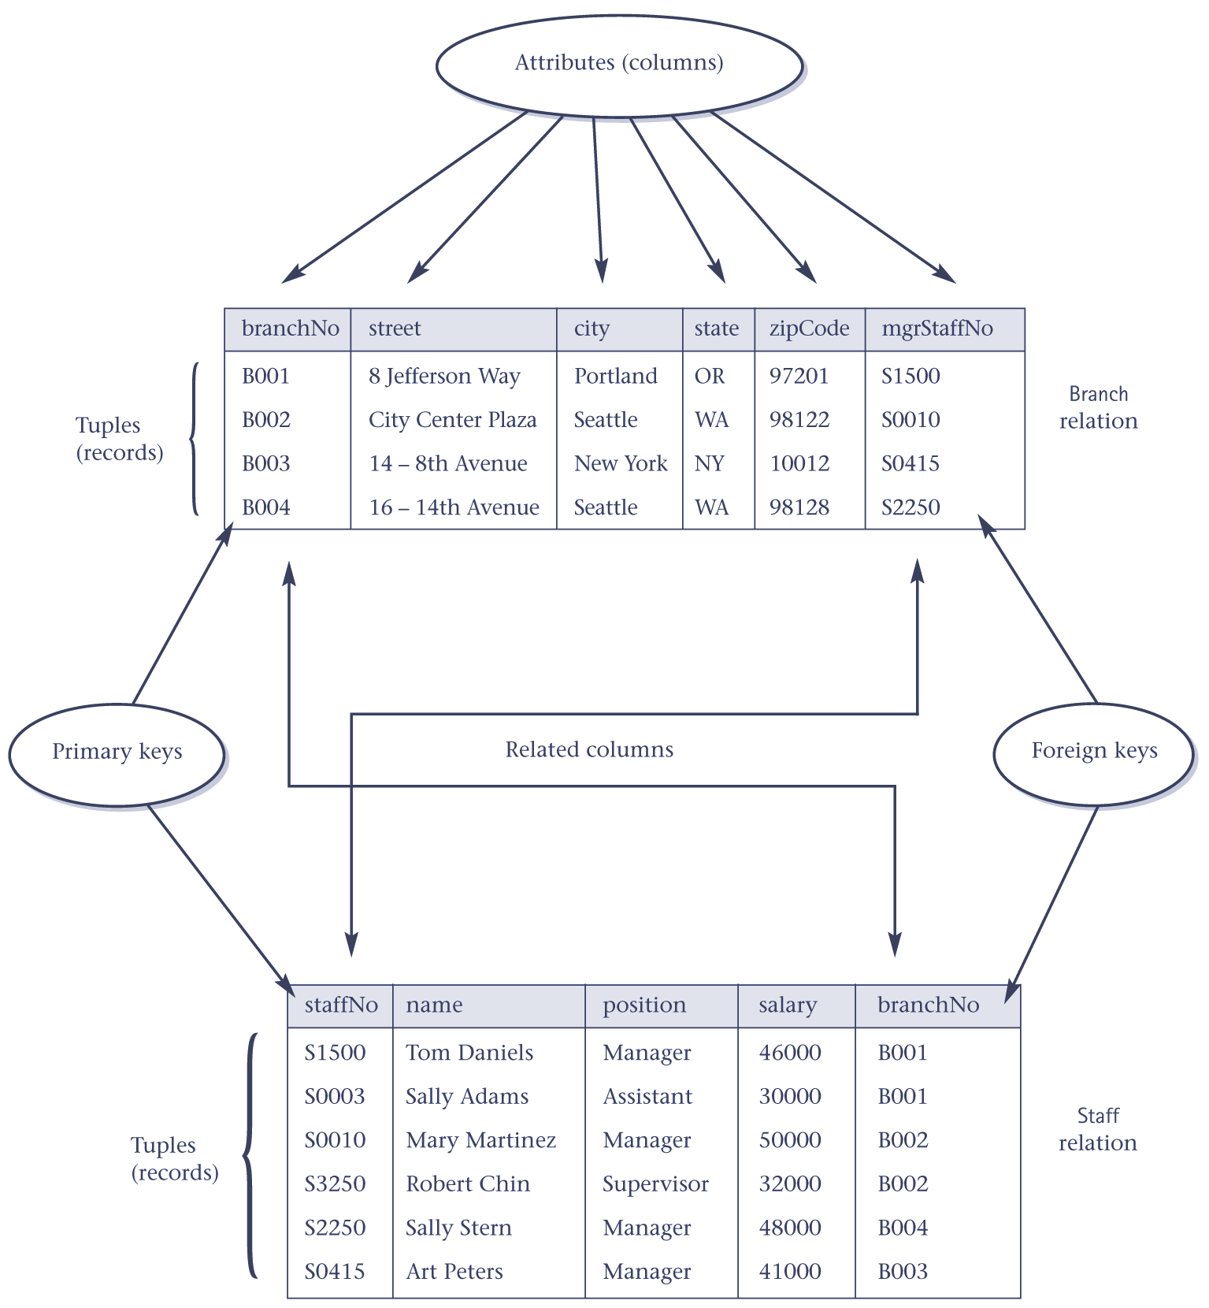
Instances of Branch and Staff (part) Relations

Slide 7
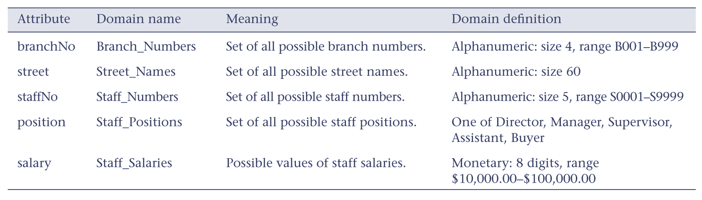
Example Attribute Domains

Slide 8
Alternative Terminology
Relation, attribute, tuple
Table, column, record
File, field, row
Combinations thereof.

Slide 9
Properties of Relations
Table name is distinct from all other table names in the database.
Each cell of table contains exactly one atomic (single) value.
Each column has a distinct name.
Values of a column are all from the same domain.

Slide 10
Properties of Relations
Each record is distinct; there are no duplicate records.
Order of columns has no significance.
Order of records has no significance, theoretically.

Slide 11
Relational Keys
Superkey
  A column, or a set of columns, that uniquely identifies a record within a table.
Candidate Key
  Superkey (K) such that no proper subset is a superkey within the table.
  In each record, values of K uniquely identify that record (uniqueness).
  No proper subset of K has the uniqueness property (irreducibility).

Slide 12
Relational Keys
Primary Key
  Candidate key selected to identify records uniquely within table.
Alternate Keys
  Candidate keys that are not selected to be primary key.
Foreign Key
  Column, or set of columns, within one table that matches candidate key of some (possibly same) table.

Slide 13
Relational Keys
Surrogate key
  created to be the record’s primary key identifier when no suitable primary key exists
  Surrogate key has no real relationship to the record to which it is assigned, other than to identify the record uniquely
  Developers configure the database to generate surrogate key values automatically
  Surrogate keys are always numerical fields, because the database generates surrogate key values automatically by incrementing the previous value by one

Slide 14
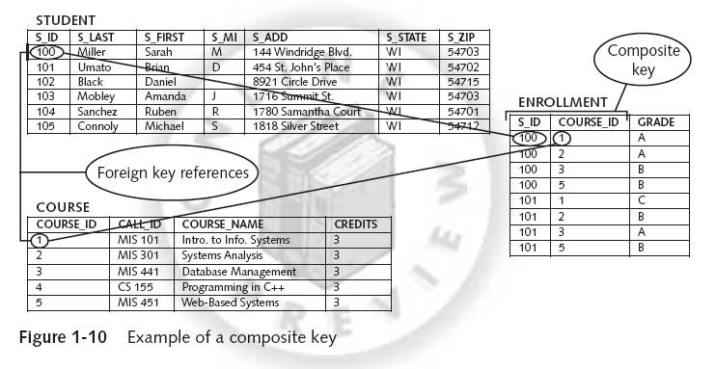
Composite Key
  is a unique key that you create by combining two or more fields
  is usually comprised of fields that are primary keys in other tables

Slide 15
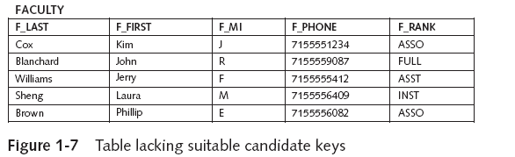
Surrogate Key

Slide 16
Relational Keys
Example: Consider the following tables
Staff(staffNo, name, position, salary, branchNo)
Branch(branchNo,street,city,state,zipCode, mgrStaffNo)
SuperKey = {staffNo, (staffNo, name), (staffNo, position), (staffNo, salary), (staffNo, branchNo), (staffNo, name, position), (staffNo, name, salary), … }
Candidate Key = {staffNo}
Primary Key = {staffNo}

Slide 17
Relational Integrity
Null
  Represents value for a column that is currently unknown or not applicable for record.
  Deals with incomplete or exceptional data.
  Represents the absence of a value and is not the same as zero or spaces, which are values.

Slide 18
Relational Integrity
Entity Integrity
  In a base table, no column of a primary key can be null.
Referential Integrity
  If FK exists in a table, either FK value must match a candidate key value of some record in its home table or FK value must be wholly null.

Slide 19
Relational Integrity
Business Rules
  Rules or policies that define or constrain some aspect of the organization.
  E.g. Bank implements a minimum amount that must be maintain in the saving account.
  E.g. Library allows students to borrow up to a maximum of 10 books.

Slide 20
Sources of Business Rules
Company managers
Policy makers
Department managers
Written documentation
  Procedures
  Standards
  Operations manuals
Direct interviews with end users

Slide 21
Relational Languages
Two main languages:
  SQL (Structured Query Language), standardized by ISO.
  QBE (Query-by-Example), alternative graphical “point-and-click” way of querying database.

Slide 22
Relational Database - Notation
Recall: A relational database consists of one or more tables/relations.
Common convention representing tables:
Branch(branchNo, street, city, state, zipCode, mgrStaffNo)
Staff(staffNo, name, position, salary, branchNo)
Video(catalogNo, title, category, dailyRental, price, directorNo)
Director(directorNo, directorName)
Actor(actorNo, actorName)

Slide 23
Relational Database - Notation
Role(actorNo, catalogNo, character)
Member(memberNo, fName, lName, address)
Registration(branchNo, memberNo, staffNo, dateJoined)
RentalAgreement(rentalNo, dateOut, dateReturn, memberNo, videoNo)
VideoForRent(videoNo, available, catalogNo, branchNo)

Slide 24
Summary
Relations are physically represented as tables, with the records corresponding to individual tuples and columns.
Properties of relational tables : each cell contains exactly one value, column names are distinct, column order and record order is immaterial, there are no duplicate records.

Slide 25
Summary
A superkey is a set of column that identifies records of a table uniquely, candidate key is minimal superkey.
A primary key is candidate key chosen for use in identification of records.
Foreign key is a field in a table that is a primary key in another table.
A surrogate Key is created to be the record’s primary key identifier when no suitable primary key exists
Entity Integrity, Referential integrity

